Slide 1

Computer Network CSE306
Lecture #0
Kick Start Session

Slide 2

Course details
LTP – 3 0 0 [Three lectures per week]
Students will complete two online lectures per week on the Coursera platform.
One lecture per week will be in offline mode for student-teacher interaction, doubt clearing, and evaluations

Slide 3
Courses to be Completed on Coursera Platform
Course Name | Specialization(s) | Web Link
The Bits and Bytes of Computer Networking | NA | https://www.coursera.org/learn/computer-networking
Computer Communications Specialization | Fundamentals of Network Communication | https://www.coursera.org/learn/fundamentals-network-communications?specialization=computer-communications
 | Peer-to-Peer Protocols and Local Area Networks | https://www.coursera.org/learn/peer-to-peer-protocols-local-area-networks?specialization=computer-communications
 | Packet Switching Networks and Algorithms | https://www.coursera.org/learn/packet-switching-networks-algorithms?specialization=computer-communications
 | TCP/IP and Advanced Topics | https://www.coursera.org/learn/tcp-ip-advanced?specialization=computer-communications

Slide 4
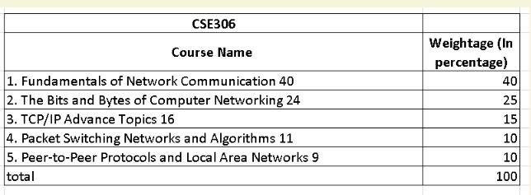
Course Wise Weightage
Note:- CA marks will be prorated based on the completion percentage of each course.

Slide 5
Course Assessment Model
Marks break up*
Attendance
CA (Two best out of three tasks)
MTE
ETE
Total
5
25
20
50
100
Mid Term Exam: All MCQ
End Term Exam: MCQ + Subjective

Slide 6
Academic Tasks
Academic Task | Objective | Detail of Academic Task | Nature of Academic Task | Academic Task Mode | Marks Allotment / Submission Week
Test 1 (MCQ) | To evaluate the conceptual and technical understanding of the concepts | Three evaluations will be conducted for each CA on OAS platform. Each evaluation will consist of 10 MCQ type questions, with each question carrying 1 mark, making a total of 10 marks per evaluation. Hence, the total marks for one CA will be 30. | Individual | Online | 30
Test 2 (MCQ) | To evaluate the conceptual and technical understanding of the concepts | Three evaluations will be conducted for each CA on OAS platform. Each evaluation will consist of 10 MCQ type questions, with each question carrying 1 mark, making a total of 10 marks per evaluation. Hence, the total marks for one CA will be 30. | Individual | Online | 30
Test 3 (MCQ) | To evaluate the conceptual and technical understanding of the concepts | Three evaluations will be conducted for each CA on OAS platform. Each evaluation will consist of 10 MCQ type questions, with each question carrying 1 mark, making a total of 10 marks per evaluation. Hence, the total marks for one CA will be 30. | Individual | Online | 30 7/27/2023

Slide 7
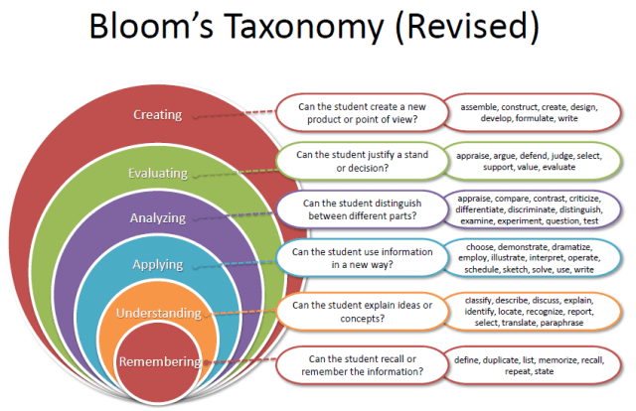
Revised Bloom’s Taxonomy

Slide 8
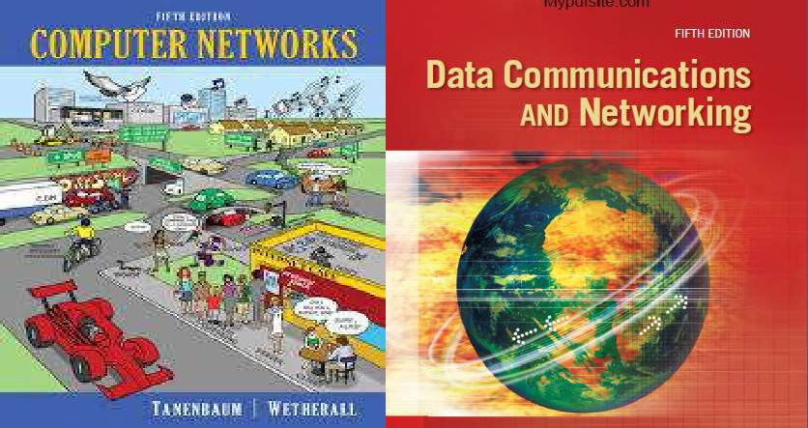
Reference Book 1
Ed 5
Text Book

Slide 9
Course Outcomes
CO:1 Recognize various network hardware component and their topologies
CO:2 Interpret the concept of data communication modulation and multiplexing in the physical layer.
CO:3 Apply principles of data link layer design and employ multiple access protocols in the network setups.
CO:4 Utilize IP addressing and packet forwarding technique in the Network setups.
CO:5 Examine and analyze different routing algorithms and the performance of unicast routing protocol in network environment.
CO:6 Classify the role and functioning of key application layer protocols and services.

Slide 10
Program Outcomes as specific to the particular course
PO1::Apply the knowledge of mathematics, science, engineering fundamentals, and engineering specialization to the solution of complex engineering problems.
PO2::Identify, formulate, review research literature, and analyze complex engineering problems reaching substantiated conclusions using first principles of mathematics, natural sciences, and engineering sciences.
PO3::Design solutions for complex engineering problems and design system components or processes that meet the specified needs with appropriate consideration for public health and safety, and cultural, societal, and environmental considerations.
PO4::Use research-based knowledge and research methods including design of experiments, analysis and interpretation of data, and synthesis of the information to provide valid conclusions.
PO5::Create, select, and apply appropriate techniques, resources, and modern engineering and IT tools including prediction and modeling to complex engineering activities with an understanding of the limitations.

Slide 11
Program Outcomes
PO6::Apply reasoning informed by the contextual knowledge to assess societal, health, safety, legal and cultural issues and the consequent responsibilities relevant to the professional engineering practice.
PO7::Apply ethical principles and commit to professional ethics and responsibilities and norms of the engineering practice.
PO8::Function effectively as an individual, and as a member or leader in diverse teams, and in multidisciplinary settings.
PO9::Communicate effectively on complex engineering activities with the engineering community and with society at large, such as, being able to comprehend and write effective reports and design documentation, make effective presentations, and give and receive clear instructions.
PO10::Demonstrate knowledge and understanding of the engineering and management principles and apply these to one’s own work, as a member and leader in a team, to manage projects and in multidisciplinary environments.
PO11::Recognize the need for, and have the preparation and ability to engage in independent and lifelong learning in the broadest context of technological change.

Slide 12
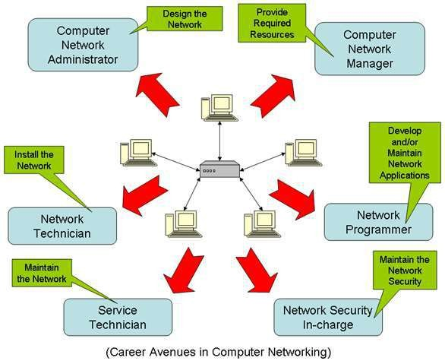
Why Study ?

Slide 13
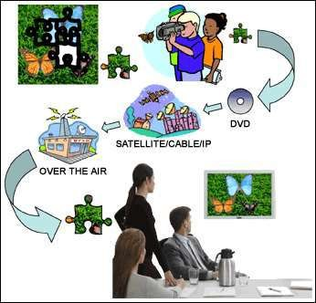

Slide 14
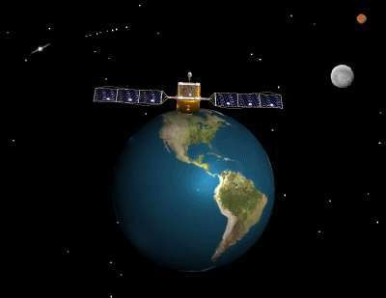

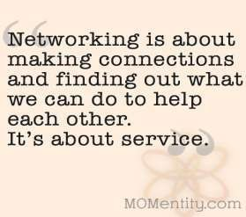
Objective of Computer Networks
Networking has revolutionized the way in which we work, connect and communicate to the world.

Slide 15

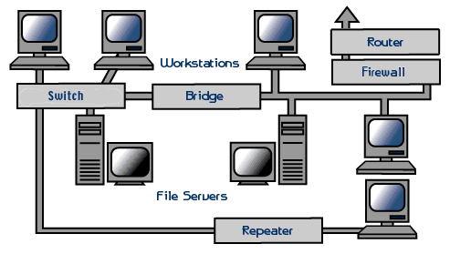
What Is Networking
A computer network or data network is a telecommunications network that allows computers to exchange data.

Slide 16
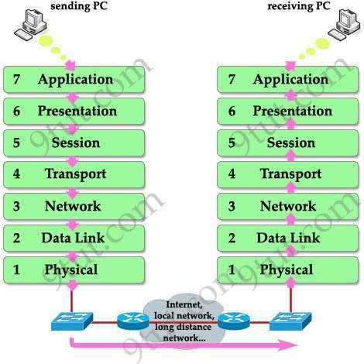
OSI and TCP Model
Unit 1

Slide 17
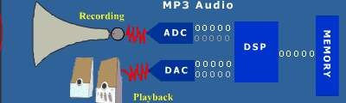
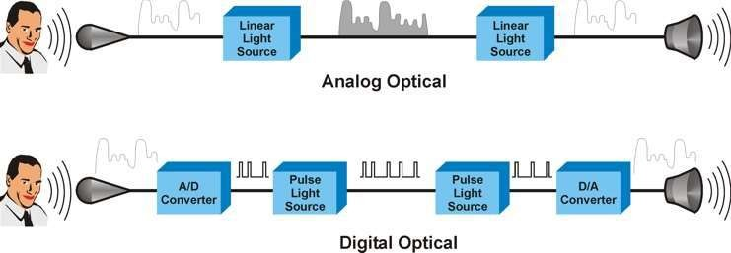
PHYSICAL LAYER: Signal & Media
Unit 2

Slide 18
DATA LINK LAYER
Unit 3
Physical Addressing Framing
Flow Control Error Control

Slide 19
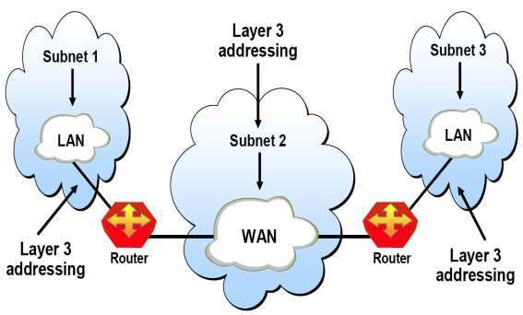
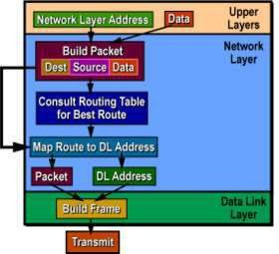
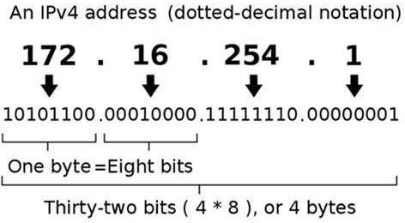
NETWORK LAYER: IP Addressing
Unit 4

Slide 20
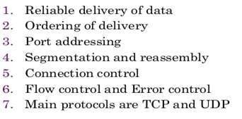
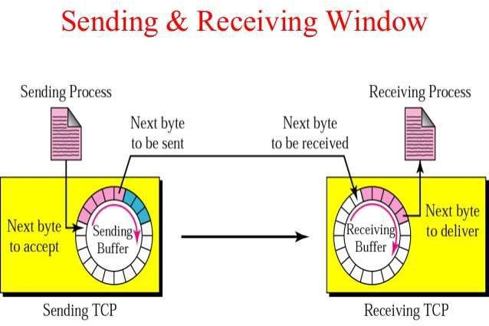
TRANSPORT LAYER
Unit 5

Slide 21

APPLICATION LAYER
Unit 6

Slide 22
Types of Network
Wired Networks
high bandwidth
low bandwidth variability
can listen on wire
high power machines
high resource machines
low delay
connected operation
Mobile Networks
low bandwidth
high bandwidth variability
hidden terminal problem
low power machines
low resource machines
higher delay
disconnected operation
-No Mobility.
Mobility.

Slide 23
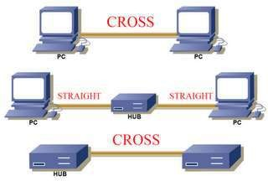
Types of Devices
Laptops
PDAs
Cell phones
Pagers
Sensors
Hub
Switch
Router etc

Slide 24
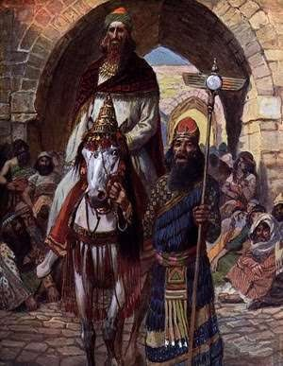




Slide 25

Challenges
Bandwidth
Security risks
Wide variety terminals and devices with different capabilities
Fit more functionality into single, smaller device
QoS

Slide 26
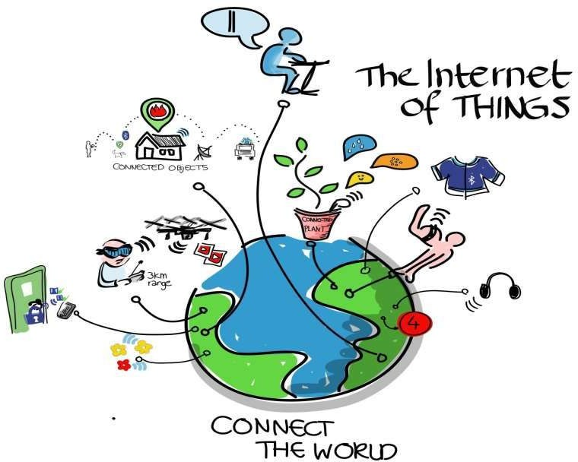

Slide 27
Limitations to Computer Network
Cyber Crime.
Need Connectivity.
Global Protocol acceptance. IPv4 and IPv6.
Power Source for Mobile Devices.
Size and Design.
Cost.

Slide 28
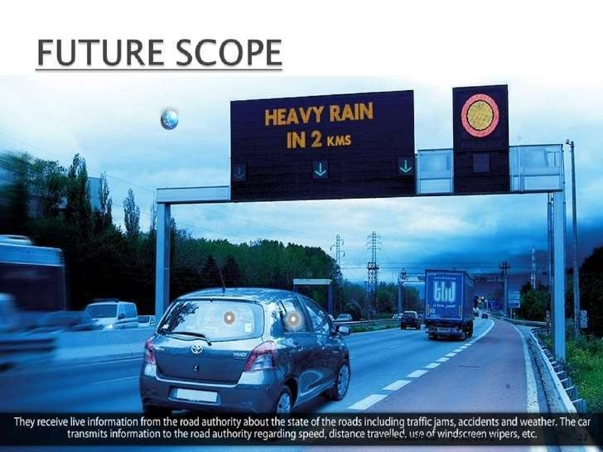

Slide 29
Benefits of the course
Understanding network concepts is crucial for IT roles.
Networking knowledge integrates with other IT disciplines (e.g., cybersecurity, cloud computing)
Develops critical thinking through diagnosing and resolving network issues.
Ability to implement robust security protocols and safeguard data.
Knowledge of network vulnerabilities and security practices.
Emphasize the value of pursuing knowledge in computer networks for personal and professional growth.

Slide 30
MOOCs/Certifications
Name of Mapped MOOC/Certification/Hackathon | Weblink | Benefit Count
CCNA (Cisco Certified Network Associate) | https://www.cisco.com/c/en/us/training-events/training-certifications/certifications/associate/ccna.html#~exam-training | CA+MTT+ETE
CompTIA Network+ | https://www.comptia.org/certifications/network | CA+MTT+ETE

Slide 31
OPEN EDUCATIONAL RESOURCE
Topics | Links
Networks and Types, Network software architecture and its layers and protocols | SMB_University_120307_Networking_Fundamentals.pdf (cisco.com)
Uses of Computer Networks, Network hardware architecture and its topologies and device like HUB | https://www.cisco.com/c/en/us/solutions/enterprise-networks/what-is-computer-networking.html
Physical layer: Signal and media, Modulation & Multiplexing | Computer Network - Data and Signals in Physical layer (beginnersbook.com)
Analog Transmission | Analog Transmission (tutorialspoint.com)
Digital Transmission | Digital Transmission in Computer Network (tutorialspoint.com)

Slide 32
OPEN EDUCATIONAL RESOURCE
Topics | Links
Data link layer, Mac sublayer | Data Link Layer in OSI Model - Scaler Topics Medium Access Control Sublayer (MAC sublayer) (tutorialspoint.com)
Network layer Ip addressing | IP Addressing: IPv4 Addressing Configuration Guide, Cisco IOS XE Release 3S - Configuring IPv4 Addresses [Support] - Cisco
Network layer: Routing, Congestion control | Computer Network - Data and Signals in Physical layer (beginnersbook.com)
Transport Layer Application layer | Transport and Application Layers - OMSCS Notes (omscs-notes.com)

Slide 33


